Slide 1
Team & Solution Overview
• Team Name: 5Gen data
• Members:
Aashiga GN
Lakshmi B
Pallavi V
• Challenge area: Track 1 (Data Insights & Visualisation) + Track 3 (Policy & Intervention Design)
• One-line solution: "We identify district-wise math competency gaps, analyze whether they are linked to socio-economic factors or instructional issues, and recommend targeted interventions.
Contact:
9994384131
7483445972
9916435329
Evaluation: Depth of analysis | Policy relevance | Cross-dataset analysis | Innovation | Clarity of insights | Visualisation & presentation

Slide 2
Problem Statement
• Educational challenge: District-level average scores hide which mathematics competencies are weak and how learning gaps differ across districts.
Uniform interventions fail to address district-specific learning needs.
• Objectives: Identify the weakest mathematics competencies across Karnataka.
Measure district-wise learning imbalance using the Severity Gap.
Examine the relationship between learning outcomes and female literacy.
Recommend evidence-based district-specific interventions.
• Key questions: Which mathematics competencies show the lowest performance?
Which districts exhibit the largest competency imbalances?
Is female literacy associated with learning performance?
Which districts require competency-specific interventions?
• Why it matters: Different districts face different learning challenges.
Understanding both what students struggle with and where the largest learning imbalances exist enables targeted resource allocation, focused teacher support, and more effective interventions.
Evaluation: Depth of analysis | Policy relevance | Cross-dataset analysis | Innovation | Clarity of insights | Visualisation & presentation

Slide 3
Dataset Understanding
• Dataset summary: 312,702 students from Grades 4–6
Covers 30 districts across Karnataka
Assessment data for 2022–23
Responses to 20 mathematics questions (Q1–Q20)
• Variables: Student: Grade, Gender
Location: District, Block, Cluster, Gram Panchayat (GP)
Assessment: Q1–Q20 (1 = Correct, 0 = Incorrect)
Socio-economic: Female Literacy (NFHS-5)
• Cleaning: Dataset pre-cleaned by Akshara Foundation
Verified:
No missing values
No duplicate records
Consistent district names
Mapped Q1–Q20 into 9 mathematics competency groups for analysis
• Assumptions: The competency mapping accurately represents the assessed mathematical skills.
District-level competency accuracy reflects overall district learning performance.
The Severity Gap measures the difference between the strongest and weakest competency within a district.
.
Evaluation: Depth of analysis | Policy relevance | Cross-dataset analysis | Innovation | Clarity of insights | Visualisation & presentation

Slide 4
Analytical Approach
• Workflow: Load Assessment Data → Map Q1–Q20 to 9 Competency Groups → Calculate Competency-wise Accuracy → Compute District-wise Severity Gap → Merge with Female Literacy Data → Visualize Results → Generate District-specific Recommendations.
• Methods: Descriptive Analysis: Measured average accuracy for each competency group.
District-wise Aggregation: Calculated competency performance for every district.
Severity Gap Analysis: Measured the difference between the strongest and weakest competency within each district.
Correlation Analysis: Examined the relationship between learning performance and female literacy.
• Models: No predictive machine learning model was used.
The project applies diagnostic analytics to identify competency gaps, district-level learning imbalances, and evidence-based intervention needs.
• Validation: Verified that the dataset contained no missing values or duplicate records.
Checked district name consistency using the official crosswalk mapping.
Validated competency rankings and severity gap calculations against district-level results.
Compared learning patterns with female literacy data to support interpretation.
Evaluation: Depth of analysis | Policy relevance | Cross-dataset analysis | Innovation | Clarity of insights | Visualisation & presentation

Slide 5
Key Insight 1
• Finding: Measurement, Division, and Place Value are the dominant weakest competency groups across Karnataka districts.
High-severity districts such as Kodagu, Mandya, Chamarajanagara, Raichur, and Chitradurga show the largest competency imbalances, with Measurement being the most common weakest competency.
• Evidence: The District Competency Imbalance chart ranks districts by Severity Gap (difference between strongest and weakest competency).
Bar colors identify the weakest competency in each district:
🟧 Measurement is the weakest competency in the majority of high-severity districts.
🟩 Division is the weakest in districts such as Kodagu and Mandya.
🟦 Place Value
🟪 Multiplication appear in fewer districts.
• Interpretation: Learning gaps are not uniform across districts—they are concentrated in specific competencies.
Districts with larger severity gaps (≈20–21 percentage points) require targeted competency-based interventions, while districts with smaller gaps (≈10–15 percentage points) exhibit more balanced learning outcomes.
Evaluation: Depth of analysis | Policy relevance | Cross-dataset analysis | Innovation | Clarity of insights | Visualisation & presentation

Slide 6
Key Insight 2
• Finding: Measurement (49.7%), Place Value (50.3%), and Division (51.1%) are the weakest mathematics competency groups across Karnataka.
In contrast, Number Sense (64.7%) and Addition (63.9%) show the highest student accuracy.
• Evidence: The Statewide Accuracy by Competency Group chart shows the average accuracy for each of the nine competency groups.
The three lowest-performing competencies are:
Measurement – 49.7%
Place Value – 50.3%
Division – 51.1%
The highest-performing competencies are:
Number Sense – 64.7%
Addition – 63.9%
• Interpretations: Students demonstrate stronger performance in basic number concepts but face greater difficulty with Measurement, Place Value, and Division.
These foundational skills should be prioritized through competency-based teacher training and remedial learning programs to improve mathematics outcomes across the state.
Evaluation: Depth of analysis | Policy relevance | Cross-dataset analysis | Innovation | Clarity of insights | Visualisation & presentation

Slide 7
Predictive / Diagnostic Analysis
• Model: Districts are analyzed using:
Competency accuracy
Severity Gap
Female literacy (NFHS-5)
The framework identifies districts requiring targeted competency-based interventions based on learning patterns.
• Metrics:
Competency Accuracy: Measures average student performance in each mathematics competency.
Severity Gap: Difference between the strongest and weakest competency within a district, indicating learning imbalance.
Pearson Correlation: Measures the relationship between female literacy and learning performance.
• Important predictors:
Female literacy rate
Competency accuracy
District-level Severity Gap
• Early warning: Districts with high Severity Gaps despite relatively good female literacy are flagged for targeted instructional support.
These districts are likely facing instructional or competency-specific challenges rather than only socio-economic disadvantage.
Evaluation: Depth of analysis | Policy relevance | Cross-dataset analysis | Innovation | Clarity of insights | Visualisation & presentation

Slide 8
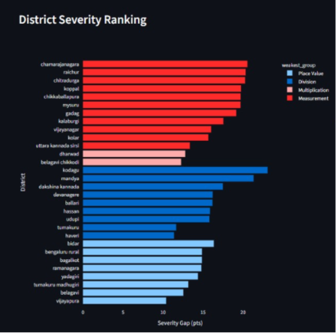
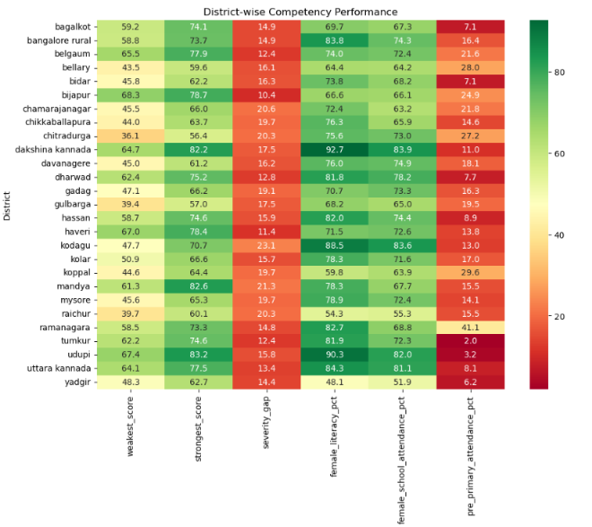
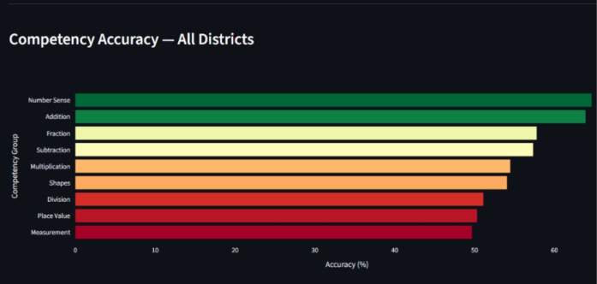
Visualization / Dashboard
Evaluation: Depth of analysis | Policy relevance | Cross-dataset analysis | Innovation | Clarity of insights | Visualisation & presentation

Slide 9
Recommendations and Road Map
• Priority actions: Strengthen Measurement, Division, and Place Value through competency-specific teacher training, as these are the weakest statewide competencies.
Prioritize high Severity Gap districts (e.g., Kodagu, Mandya, Chamarajanagara, Raichur, and Chitradurga) with targeted remedial learning programs.
Provide broader academic support in districts where low learning outcomes coincide with lower female literacy.
• Impact: Improves student learning by addressing district-specific competency gaps rather than general mathematics performance.
Enables evidence-based resource allocation for teachers, schools, and remedial programs.
Supports policymakers in prioritizing districts with the greatest learning imbalance.
• Feasibility: Uses existing GKA/Akshara assessment data and NFHS-5 socio-economic indicators.
Requires no additional data collection, making the framework cost-effective.
Can be integrated into existing teacher training and remedial education programs and scaled to future assessment cycles.
Evaluation: Depth of analysis | Policy relevance | Cross-dataset analysis | Innovation | Clarity of insights | Visualisation & presentation

Slide 10
Innovation & Impact
• Novelty: Introduces the Severity Gap metric to distinguish overall low performance from competency-specific learning imbalances.
Integrates learning assessment data with female literacy to support evidence-based intervention planning.
• Scalability: The framework can be applied across all Karnataka districts and future assessment years.
Can be adapted to other states or subjects by updating the competency mapping and assessment data.
• Limitations: Analysis is based on a single assessment year (2022–23).
Correlation identifies associations, not causation.
Uses a limited socio-economic indicator (female literacy); additional factors such as teacher availability and school infrastructure were not included.
• Expected impact: Enables district-specific, competency-focused interventions instead of blanket improvement programs.
Supports better resource allocation, teacher training, and remedial planning.
Promotes data-driven decision-making to strengthen foundational mathematics learning.
Evaluation: Depth of analysis | Policy relevance | Cross-dataset analysis | Innovation | Clarity of insights | Visualisation & presentation

Slide 11
Conclusion & Key Takeaways
• Top takeaways: Measurement, Division, and Place Value are the lowest-performing mathematics competency groups across Karnataka.
The Severity Gap reveals that learning imbalances vary across districts, highlighting the need for district-specific interventions.
Female literacy explains part of the variation in learning outcomes, but competency imbalances also indicate instructional challenges, making targeted interventions more effective than one-size-fits-all programs.
• Next steps: Extend the analysis to future assessment years to monitor learning trends over time.
Incorporate additional datasets such as UDISE+ teacher availability, school infrastructure, and student attendance for deeper analysis.
Develop an interactive dashboard to help policymakers monitor district performance and intervention outcomes.
• Thank you
Evaluation: Depth of analysis | Policy relevance | Cross-dataset analysis | Innovation | Clarity of insights | Visualisation & presentation

